Slide 1
Gameweek 3

Slide 2
Choose new players based on xGI
Need to be high on the charts
Need to be having end product as well
Notes:
Sql code
CREATE TABLE gw2 (
name varchar(255),
position char(3) CHECK (position in ('GK', 'DEF', 'MID', 'FWD')),
team varchar(255),
xP float,
total_points integer);
COPY gw2(name, position, team, xP, total_points)
fpl-# FROM '/mnt/c/Users/siyang/Documents/GitHub/data-driven-fpl/23-24-season/gw3/gw2_modified.csv'
fpl-# DELIMITER ','
fpl-# CSV HEADER;

Slide 3
Players who needed to be transferred out
Gabriel unlikely to play a key role
Soucek is injured with concussion
Joao Pedro needs more time to adjust to new surroundings

Slide 4
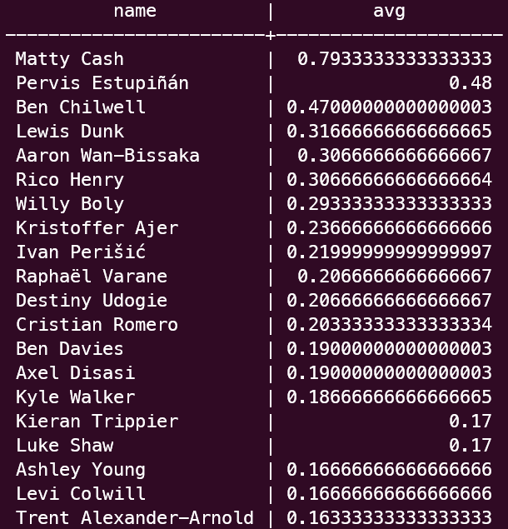
Average xGI for the past 3 weeks (DEF)
Notes:
CREATE TABLE gw3_players (
fpl(# name varchar(255),
fpl(# position char(3) CHECK (position in ('GK', 'DEF', 'MID', 'FWD')),
team varchar(255),
fpl(# expected_goal_involvements float,
fpl(# element integer,
fpl(# total_points integer);
COPY gw3_players(name,position,team,element,expected_goal_involvements,total_points)
FROM '/mnt/c/Users/siyang/Documents/GitHub/data-driven-fpl/23-24-season/gw4/merged_gw.csv'
DELIMITER ','
CSV HEADER;
Top twenty
Chose Matty Cash, has end product with high average xGI to boot
SELECT name, avg(egi)
FROM gw3_players
WHERE position = ‘DEF' GROUP BY name
ORDER BY avg(egi) DESC
LIMIT 20;

Slide 5
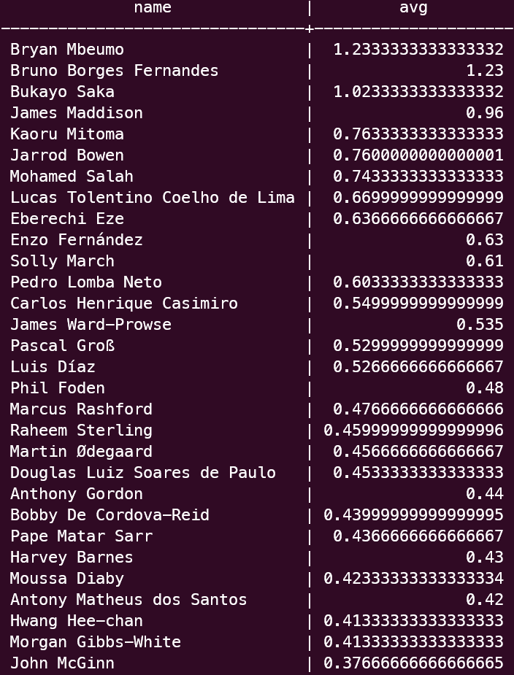
Average xGI for the past 3 weeks (MID)
Notes:
Top twenty
Chose Pape Matar Sarr (24th), because of budgetary concerns.
Has got the goals and the assists to back it up as well.
SELECT name, avg(egi)
FROM gw3_players
WHERE position = 'FWD' GROUP BY name
ORDER BY avg(egi) DESC
LIMIT 20;

Slide 6
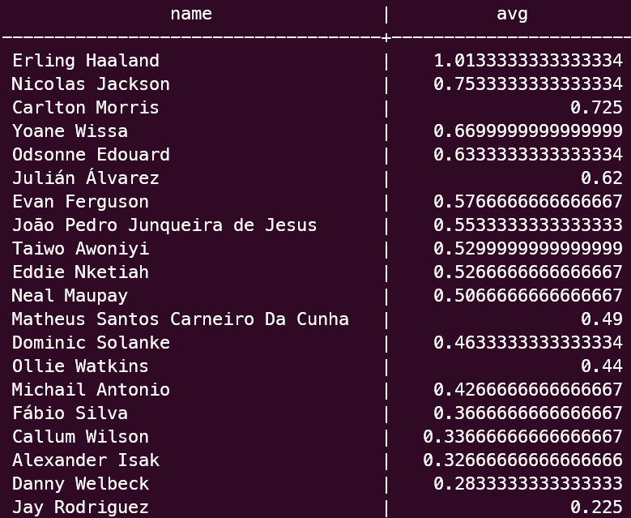
Average xGI for the past 3 weeks (FWD)
Notes:
Top twenty
Chose Yoane Wissa, has end product with high average xGI to boot
Earlier forwards are too expensive. Morris has less games played so far, less accurate.
Though it is impressive that playing in a shit team, Morris has good expected goal involvements
SELECT name, avg(egi)
FROM gw3_players
WHERE position = 'FWD' GROUP BY name
ORDER BY avg(egi) DESC
LIMIT 20;

Slide 7
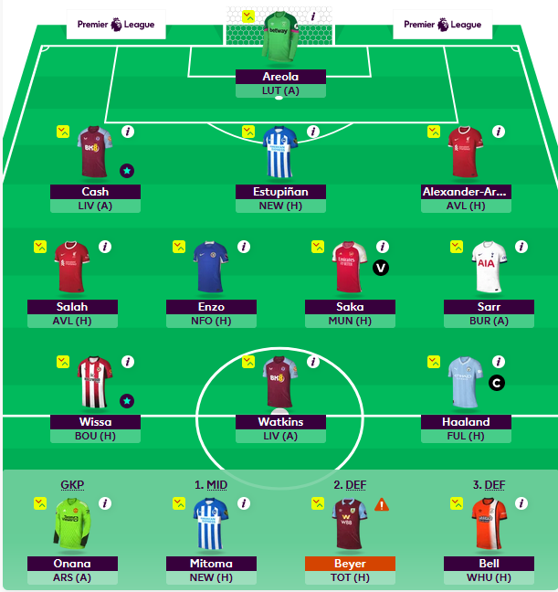
Final Squad
Gabriel -> Cash
Mitoma -> Sarr
Joao Pedro -> Wissa
Onana -> Areola (Easier fixture)

